Slide 1




BASIS OF HTML AND CSS
AN INTRODUCTION ABOUT BUILDING WEBSITES
MUHAMMAD MUSAWAR ALI SHAH

Slide 2


ABOUT WEB DEVELOPMENT
What is web development?
Web development, also known as website development, refers to the tasks associated with creating, building, and maintaining websites and web applications that run online on a browser.
It includes front-end and back-end development.
In this presentation, we will only discus about html and css

Slide 3
Hierarchy Diagram
Web development
Front-end
HTML (Structure)
CSS (Styling)
Back-end
Node.js
JavaScript (functionity)
MongoDB

Slide 4



ABOUT HTML
HTML (Hyper Text Markup Language
The standard language for creating web pages.
Define structure of web pages like Headings paragraphs, images, videos and all the other structures.

Slide 5
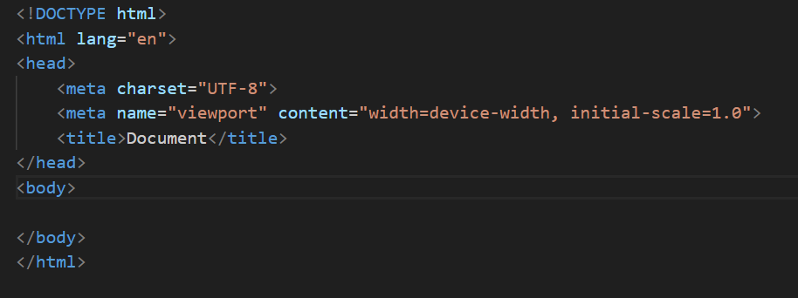
STRUCTURE OF HTML
Command | Functions
<!DOCTYPE html> | Declares document type
<html> | Root element
<head> | Define head section
<body> | Content to display on web page

Slide 6
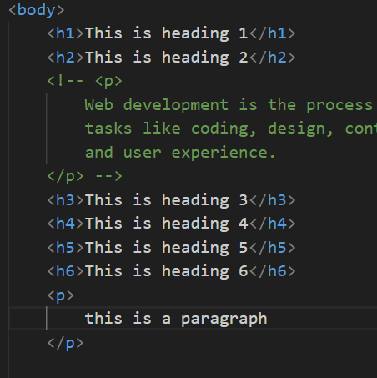
HEADING AND PARAGRAPHS
Headings
• Different heading tags from <h1> to <h6>
Paragraphs
• Creating paragraphs using <p>
Example:
<h1>This is a Heading</h1>
<p>This is a paragraph.</p>

Slide 7
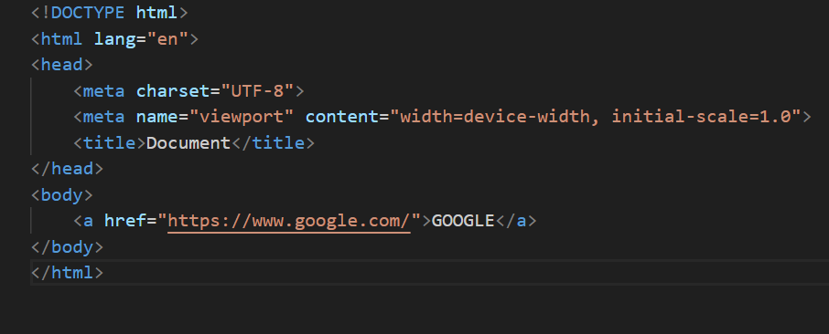
HTML LINKS
Adding Links
• Using <a> to create hyperlinks
Example:
<a href='https://www.example.com'>Visit Example</a>

Slide 8
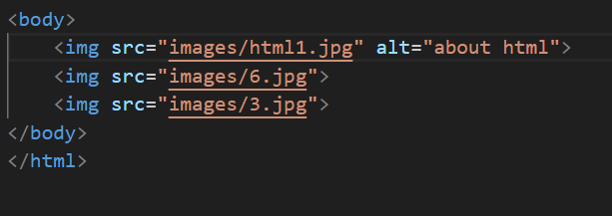
HTML IMAGES
Embedding Images
• Using <img> tag and attributes like src, alt
Example:
<img src='image.jpg' alt='My Image'>

Slide 9
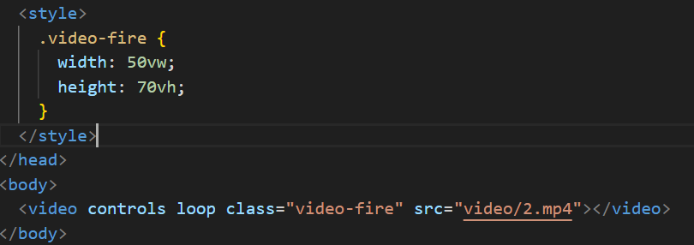
HTML VIDEOS
Embedding Videos
• Using <video> and attributes like controls, autoplay
Example:
<video controls>
<source src='video.mp4' type='video/mp4'>
</video>

Slide 10
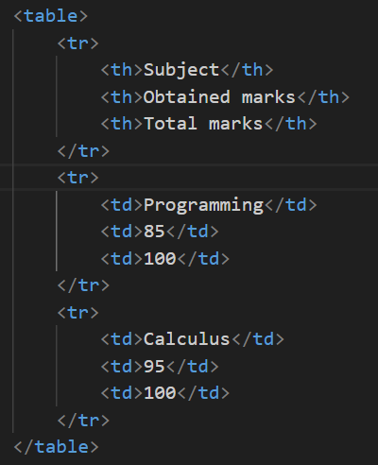
HTML TABLES
What are Tables?
• How to create tables using <table>, <tr>, <td>
Example:
<table>
<tr>
<td>Row 1, Column 1</td>
<td>Row 1, Column 2</td>
</tr>
</table>

Slide 11
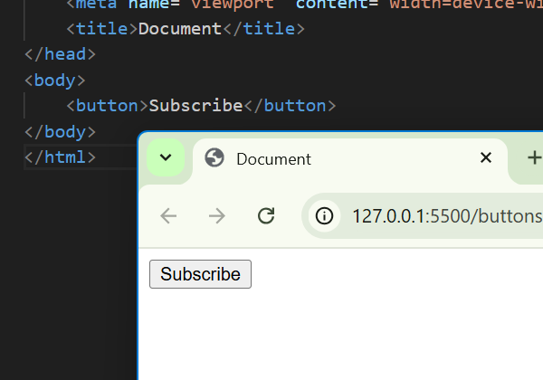
HTML BUTTONS
What are Buttons?
• Creating buttons using <button>
Example:
<button>SUBSCRIBE</button>

Slide 12
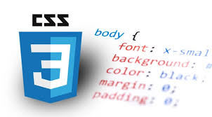
ABOUT CSS
What is CSS?
• Syntax and structure of CSS
Selectors and Properties
• How to apply CSS to HTML elements
Example:
p {
font-size: 16px;
}

Slide 13
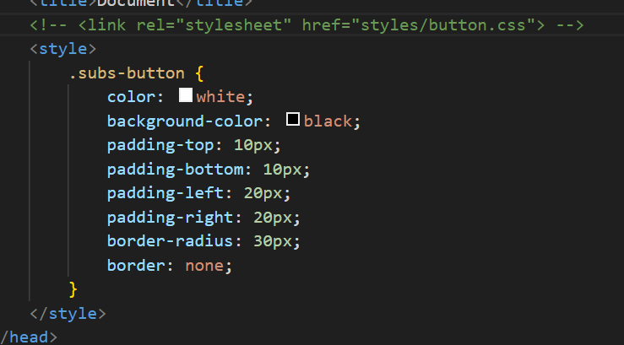
ABOUT CSS
There are different ways to link html and css:
1: Link by using <style> tag in the <header> or <body> section.
2: by using <link> tag:
For example:
<link rel = “stylesheet” href = “style.css”>

Slide 14
CSS STYLING FOR BUTTONS
Customizing Buttons
• Using CSS to style buttons, change color, size, etc.
Example:
button {
background-color: blue;
color: white;
}

Slide 15

CONCLUSION
HTML provides the structure for web pages, allowing us to organize content using tags and elements.
CSS enhances the visual presentation of this content, offering control over layout, colors, fonts, and positioning.

Slide 16

THANK YOU

